Slide 1
OS-Climate Data Commons
Overview
Notes:
Heather to introduce Vincent

Slide 2
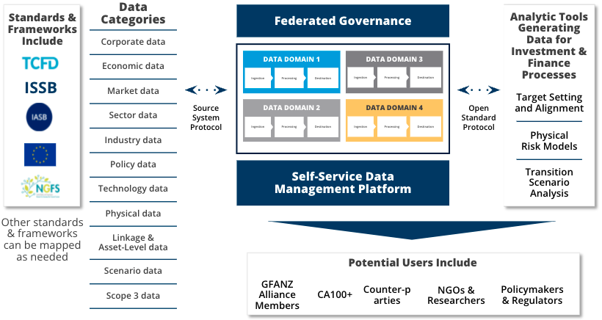
OS-Climate & Global Data Commons
OS-Climate applies a community-based open-source approach to solve data & analytics challenges required for investment to achieve Paris Climate Accord goals
OPEN SOURCE COMMUNITY
Governance, licensing, and collaboration structures enabling stakeholders to share cost, intellectual property, and effort.
Joint projects for new data, modelling, standards, and supporting technology
GLOBAL DATA COMMONS
Curated access to library of public and private sources, for both transition and physical risk/opportunity
More accurate corporate historical and forward-looking climate & ESG metrics as a public good
ANALYTICS TOOLS
Integrate climate-related risk and opportunity into decisions by investors, financial institutions, regulators, etc
Scenario analysis and alignment tools for climate change risk, physical risk and transition risk

Slide 3
A Data Mesh provides faster and broader access to climate data
Data Warehouse
Data Lake and Lakehouse
Data mesh
Single point of access to all your data
ETL required
ELT required
Query federation
Cost-effective scaling and elasticity
Cost grows with data retained
Separation of storage and compute
Separation of storage and compute
Easily access new and existing data
ETL required
ELT required
No data movement required
Global security and compliance
Limited, by region
Limited, by region
Global / hybrid / multi-cloud data access
ANSI SQL interface
Specialized skills required (Spark, python, etc)
Specialized skills required (Spark, python, etc)
SQL-based interface

Slide 4
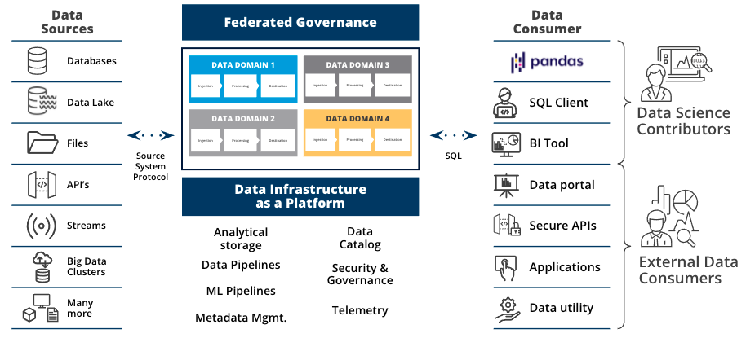
OS-Climate Data Commons Architecture Overview
Moving away from centralized data monoliths by adopting a
distributed data mesh approach
Self-service data infrastructure
Standardized self-service infrastructure and tooling for creating, maintaining and managing data products
Decentralized data product ownership
Domain data product owners are responsible for all capabilities within a given domain, including discoverability, understandability, quality and security of the data
Federated governance
Common operating standards around data / metadata / data lineage management, quality assurance, security and compliance policies
Notes:
The platform supports data availability and observability through data democratization via self-serve data infrastructure as a platform. A self-service platform is fundamental to a successful data mesh architectural approach where data can be made discoverable and shareable easily across an organization and ecosystem through open tools and readily available infrastructure supporting data creation, storage, transformation, distribution.
The platforms supports data comparability through domain-oriented decentralized data ownership and architecture i.e. data is treated like a product. The goal is to stop proliferation of data puddles to “connect” the data with proper referential, identifiers in order to have collections of data aligned with business goals.
The platform supports data reliability through a federated computational governance around data access, data lifecycle management, compliance and standards. This supports a data as code approach where the data pipeline code, the data itself and data schema are versioned so as to have transparency and reproducibility (time machine), while enforcing authentication and authorization required for data access management with consistent policies across the platform and throughout the data lineage

Slide 5

Data Commons: Based on Open Data Hub and Operate First
Upstream code enhanced with operational excellence
Open Data Hub
Community driven upstream meta-project demonstrating AI/ML platform on Red Hat OpenShift comprised of open source projects
Operate First (https://www.operate-first.cloud/)
Incorporate operational experience into Open Data Hub - operating software and services in the Open for our community members
OS-Climate Data Commons
Data science platform based on Open Data Hub and delivered as a cloud service on Red Hat OpenShift on any public or private cloud provider

Slide 6













Open Data Hub: an open source ML architecture blueprint
GOALS
Provide an end-to-end AI/ML platform leveraging Open Source components
One stop easy operator deployment on Enterprise Kubernetes
Provide Tools for each stage of the data science process and for all AI/ML user personas including:
Development tools for Data Scientists
ELT tools used by Data Engineers
Monitoring tools for model and services used by DevOps
Act as a “glue” for a rich collection of open source data science projects, which also have enterprise offering

Slide 7







OS-Climate Data Commons Technical Approach
Building a blueprint for a distributed data platform on top of Open Data Hub
Major capabilities being added to support the Federated Data Governance Layer:
FEDERATED DATA GOVERNANCE
Open Table Format for big data analytics, handling partitioning and time-travel / rollback (Apache Iceberg)
Automated data versioning and data lineage (Pachyderm)
Metadata management, data discovery, data quality, observability (OpenMetadata)
Fine-grained Role Based Access Control (RBAC) with row-level and column-level permissions (Trino)
Data Protection (IBM Fybrik + OPA)
Non-Relational DBs
+
+
Streaming Data
Operational RDBMS
Data Lake
Data Warehouse

Slide 8
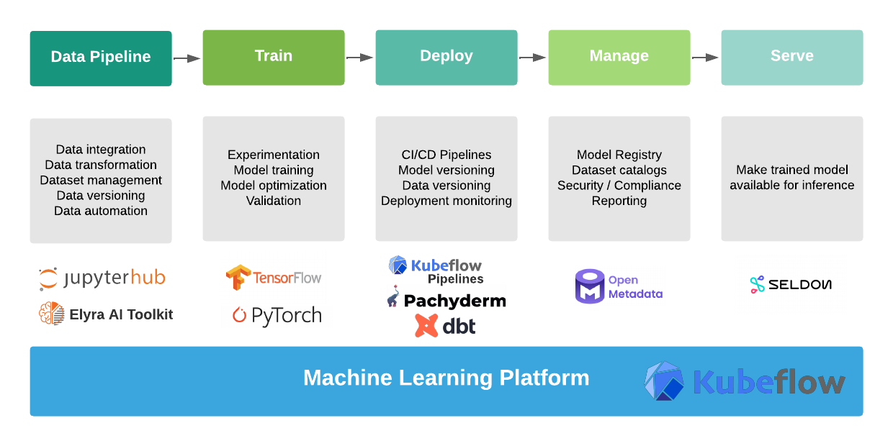
Architecture: Data Pipelines

Slide 9
Data Science Platform Roadmap
Layer | Role | What we have now | Roadmap
Data Pipeline | Data integration, transformation, versioning, automation and overall management. | Build and manage end-to-end data pipelines on Jupyter notebooks provided as a service. Elyra provides visual pipeline editor and batch management with notebook and python scripts, as well as version control with Github. | Data testing, documentation, and profiling (great_expectations)
Train | Model training, optimization and validation. | Training of ML models via any available training operator in Kubeflow.
Deploy | CI/CD pipelines development and management, model, experiment and data versioning. | Pipeline automation via Elyra / Kubeflow / Airflow. Data-driven pipelines, data versioning (Pachyderm), data lineage (DBT). | Improvements in templating / automation of metadata ingestion and management.
Manage | Data and metadata catalogs for data sets / pipelines / models. Security and compliance management. | Dataset metadata is managed into a data catalogue (OpenMetadata) and refreshed / versioned automatically. | Integration of metadata for security and compliance (Apache Ranger / Fybrik).
Serve | Make trained model available for inference to tool / application. | Kubeflow supports KFServing and Seldon Core by default. It has not been tested / documented.

Slide 10
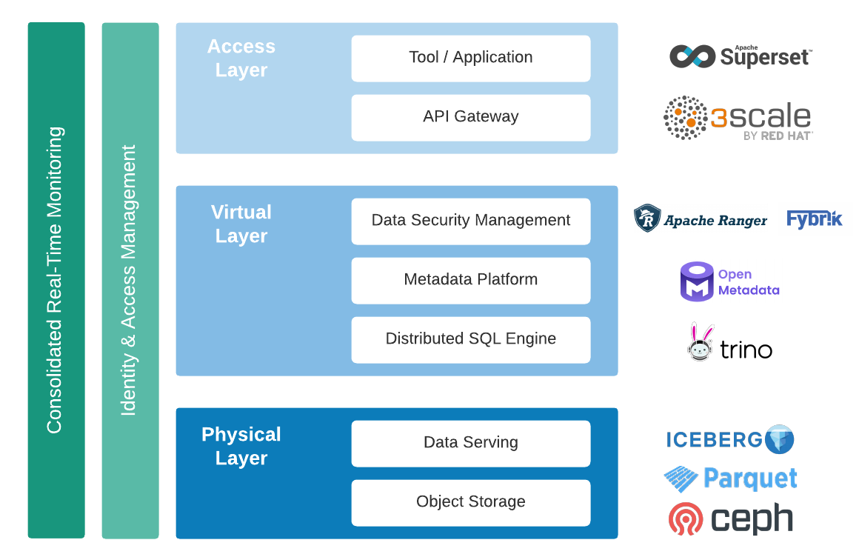
Architecture: Data Management

Slide 11
Data Access Management
Layer | Role | What we have now | Roadmap
Object Storage | Secure access to data source for ingestion | Currently based on S3 with secret-based access controls. Proprietary data sits on standalone bucket. Secrets are only provided for ingestion pipelines developers. | Automatic secret retrieval by automated ingestion pipeline for production pipelines. Container storage implementation and review of data ingestion so it is not infrastructure-specific (boto3).
Data Serving | Manage data and schema versioning automatically with ACID transactions. | anage data and schema evolution automatically. Time travel enables reproducible queries that use exactly the same table snapshot, or lets users easily examine changes. Version rollback allows users to quickly correct problems by resetting tables to a good state.
Distributed SQL Query Engine | Centralized data access and analytics with query federation. Authentication and data access controls for all data queries. | Integration with GitHub SSO via temporary JTW. Access management by catalog, schema (source / pipeline), table (data set), column (data elements). Can filter by row and mask data. integration with data catalogue (OpenMetadata). | Support of complex data types such as GeoTIFF.
Metadata Platform | Data schema & metadata management, lineage at the dataset level, data catalogue browse and search. | Data schema and metadata management, data catalogue. | Data compliance management at metadata level.
Data Security Management | Enable, monitor and manage data security across the platform (Admin GUI with authorization management and audit). | NA | Centralized management and monitoring of access at query engine level. Data security management at metadata level.
API Gateway | Enforce policies which control security aspects such as the authentication, authorization of services acquiring data for external applications / tools. | NA | API Gateway with distributed data management by data owner.

Slide 12
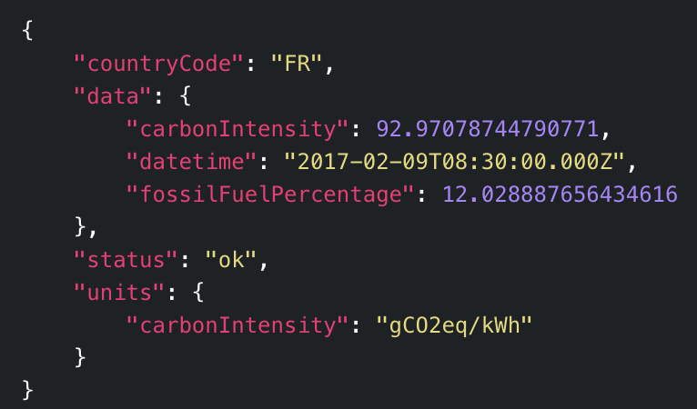
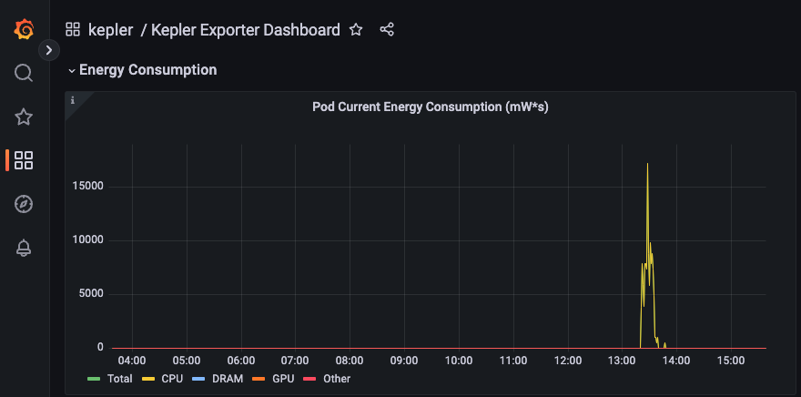


Demonstration Scope
Enabling real-time energy consumption and carbon emissions reporting through integration of Kepler with CO2 emissions statistics
CO2 emission intensity
+
CO2 footprint at Pod, Container, Service level
Kepler
Power measurement
Data center power efficiency
Data Center PUE
https://www.youtube.com/watch?v=dd-6rqp_qlA

Slide 13
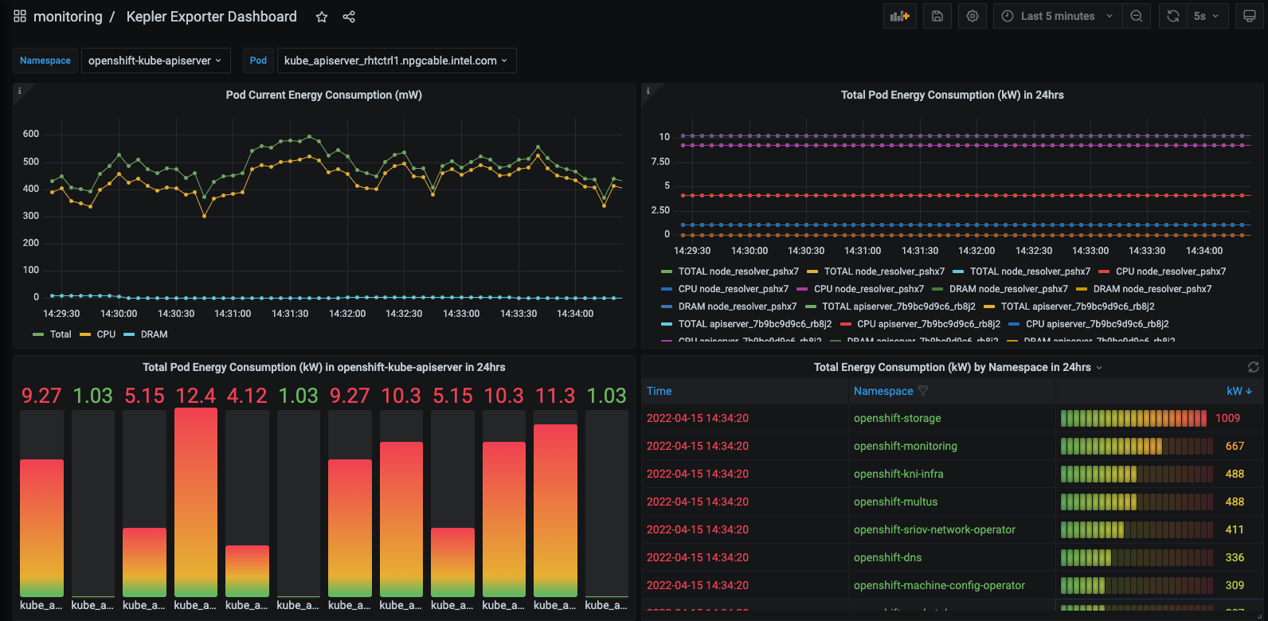

Kubernetes Efficient Power Level Exporter (Kepler)
Kepler uses uses eBPF to probe energy related system stats and exports as Prometheus metrics.
Red Hat, IBM, Intel are major contributors
Measures K8s node energy usage thru processor Running Average Power Limit (RAPL) interfaces
Current support x86_64, being extended to support ARM64 and S390 platforms
Estimates pod energy usage from node usage, including CPU / GPU / RAM, leveraging ML models for the estimation
More accurate than existing dashboards such as CCF / Scaphandre which report energy consumption based on CPU time
Project applied for CNCF Sandbox
Notes:
References:
https://static.sched.com/hosted_files/ossna2022/6c/Sustainability%20the%20Container%20Native%20Way%20-%20Huamin%20Chen%2C%20Red%20Hat%20%26%20Chen%20Wang%2C%20IBM.pptx.pdf

Slide 14
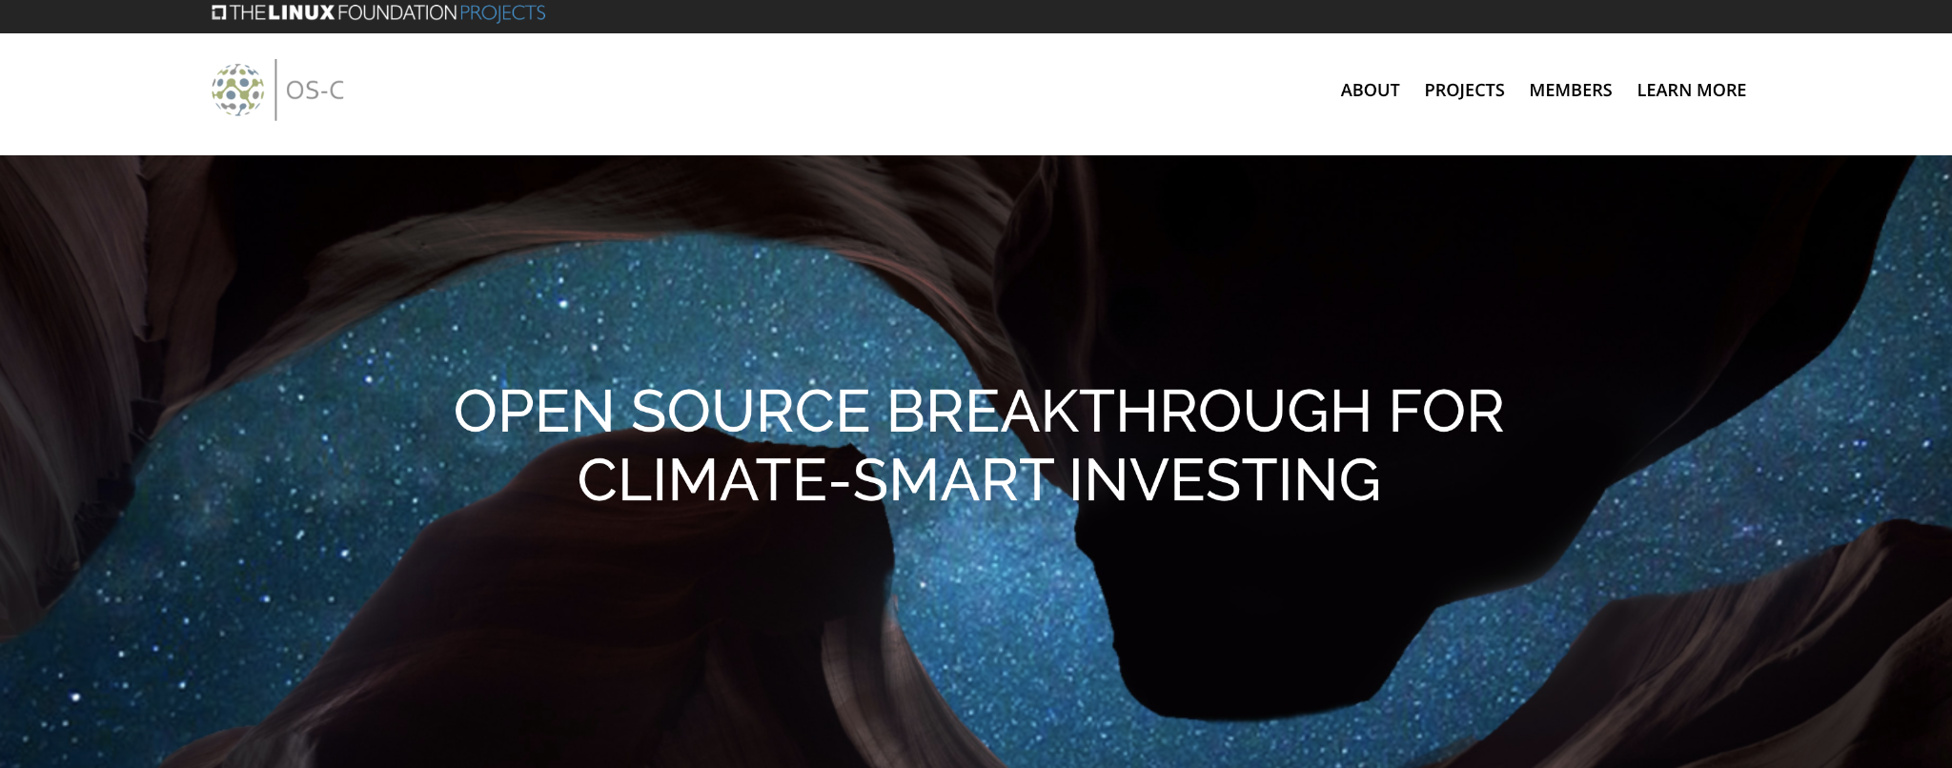
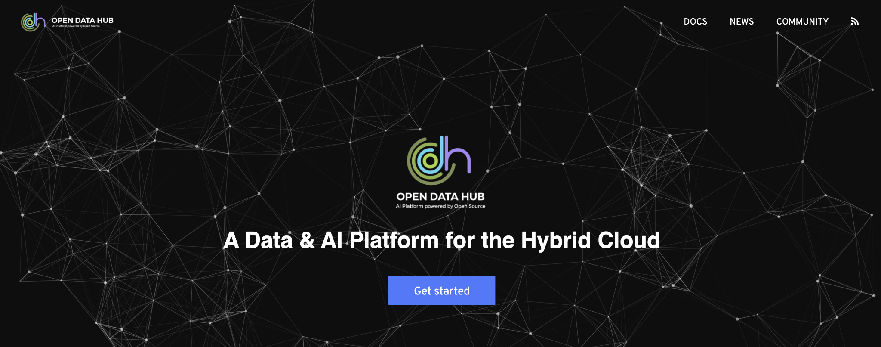
Next Steps: Find Out More
Open Data Hub community page provides a Get Started guide at https://opendatahub.io/
OS-Climate Data Commons Architecture: https://github.com/os-climate/os_c_data_commons
OS-Climate Data Commons article: https://towardsdatascience.com/making-climate-data-easy-to-find-use-and-share-5190a0926407
Kepler GitHub: https://github.com/sustainable-computing-io/kepler

